Slide 1

Religion Unbound
Finding Faith in a Secular Age

Slide 2
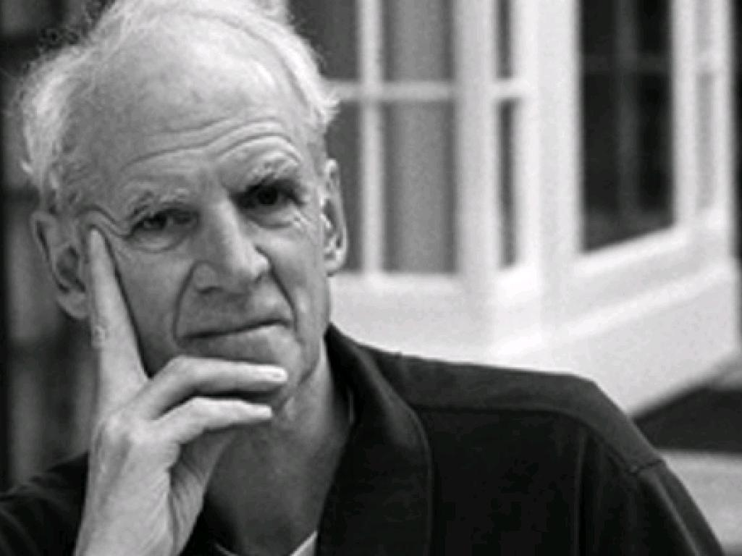
Charles Taylor
A Secular Age
Notes:
Charles Taylor, professor emeritus of McGill University in Montreal, and winner of the Templeton Prize, published in 2007 his monumental work, A Secular Age, which was an expanded version of his 1999 Gifford Lectures. He asks, 'What does it mean to say that we live in a secular age?'

Slide 3
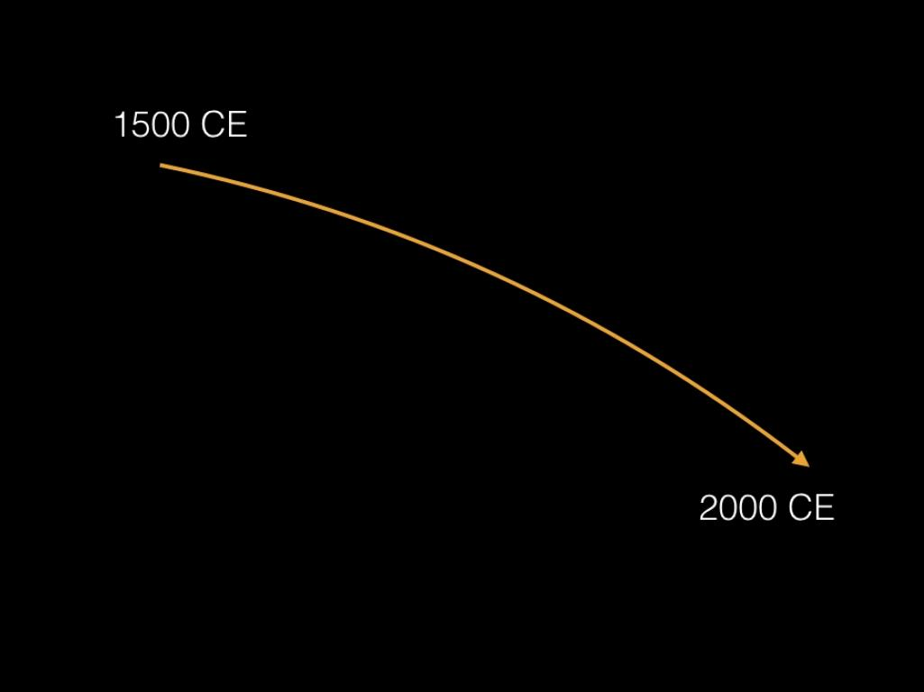
Notes:
He looks at the changes in religion and society from 1500 to 2000 and asks, "Why is it so hard to believe in God in (many milieux of) the modern West, while in 1500 it was virtually impossible not to? (Age, 539)

Slide 4
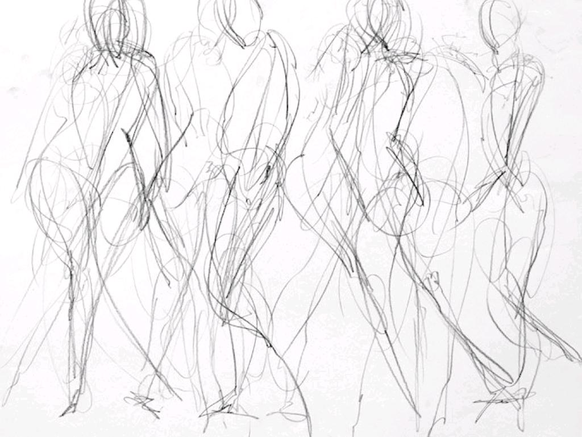
SECULARITY
Notes:
What does it mean to say we live in a secular age, he asks. Most of us would agree that we in the West live without a connection in our politics to God or to an ultimate reality.

Slide 5
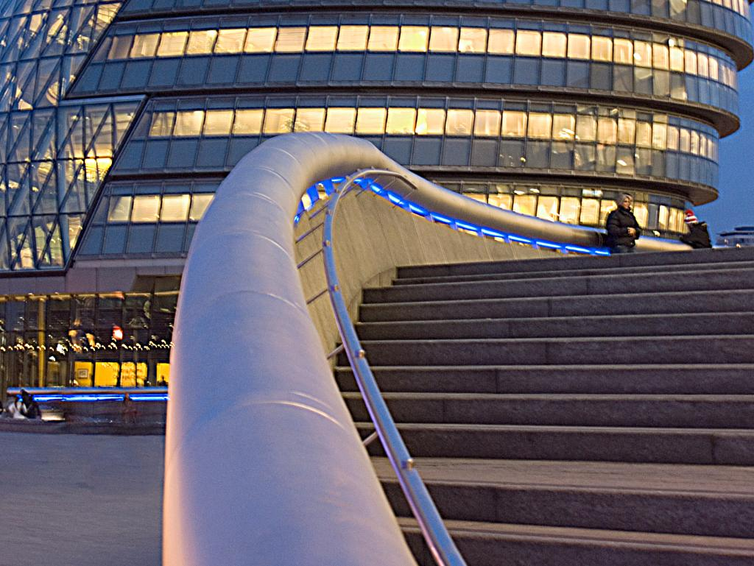
PUBLIC SPACES EMPTIED OF
GOD
cc: FiveTimes5 - https://www.flickr.com/photos/31838481@N05
Notes:
"One understanding of secularity then is in terms of public spaces. These have been allegedly emptied of God, or of any reference to ultimate reality." (Age 2)

Slide 6
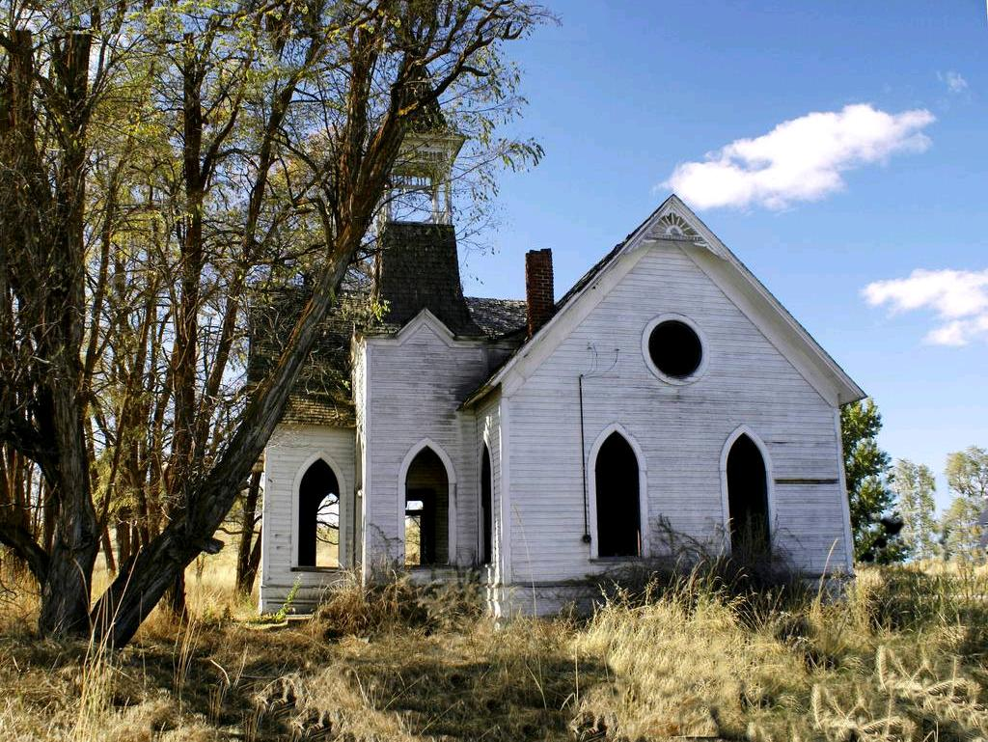
FALLING AWAY FROM
RELIGIOUS BELIEF
cc: swainboat - https://www.flickr.com/photos/22563225@N04
Notes:
In a second meaning, "secularity consists in the falling off of religious belief and practice, in people turning away from God, and no longer going to Church." (Age, 2)

Slide 7

GOD
AN OPTIONAL ALTERNATIVE
cc: álvvur. - https://www.flickr.com/photos/15605105@N04
Notes:
But while accepting these conditions of secularization, Taylor proposes a third which focuses on the conditions of belief. "The shift to secularity in this sense consists . . . of a move from a society where belief in God is unchallenged and indeed, unproblematic, to one in which it is understood to be one option among others, and frequently not the easiest to embrace." (Age 3)

Slide 8

NOVA EFFECT
WIDENING OF ALTERNATIVES TO CHRISTIANITY
cc: miuenski - https://www.flickr.com/photos/10757690@N03
Notes:
The development of contemporary secularity can be seen in three stages. The first arises in the 18th century as an exclusive humanism which stands over against the Church and God. The second phase saw a further diversification--wide variety of moral/spiritual options in a nova effect up to the present. The third arises in a culture of 'authenticity' or expressive individualism.' (Age 299)

Slide 9

BELIEF IN
TRANSCENDENT REALITY
cc: windiepink - https://www.flickr.com/photos/56455887@N00
Notes:
". . . This whole book is an attempt to study the fate in the modern West of religious faith in a strong sense. This strong sense I define, to repeat, by a double criterion: the belief in transcendent reality, on one hand . . ." (Age 510)

Slide 10

ASPIRATION TO
TRANSFORMATION
Notes:
". . . and the connected aspiration to a transformation which goes beyond ordinary human flourishing on the other." (510)

Slide 11

"An age or society would then be secular or not, in virtue of the conditions of experience of and search for the spiritual."
— Charles Taylor
Notes:
"The change I want to define and trace is one which takes us from a society in which it was virtually impossible not to believe in God, to one in which faith, even for the staunchest believer, is one human possibility among others." (Age, 3)

Slide 12

What is the lived experience of a believer or a nonbeliever?
Notes:
Taylor wants to understand what the lived experience of a believer or a nonbeliever really is. His view is that what might appear secular to believers is actually a search for the transcendent and an aspiration to be more than just a self-contained and moral person.

Slide 13

SPIRITUAL QUEST
OR RELIANCE ON AUTHORITY?
Notes:
"My contention is that these remain till this day the basis of two kinds of religious sensibility, those which underlie respectively the new kinds of spiritual quest, on one side, and the prior option for an authority which forecloses them on the other." (Age, 512)

Slide 14
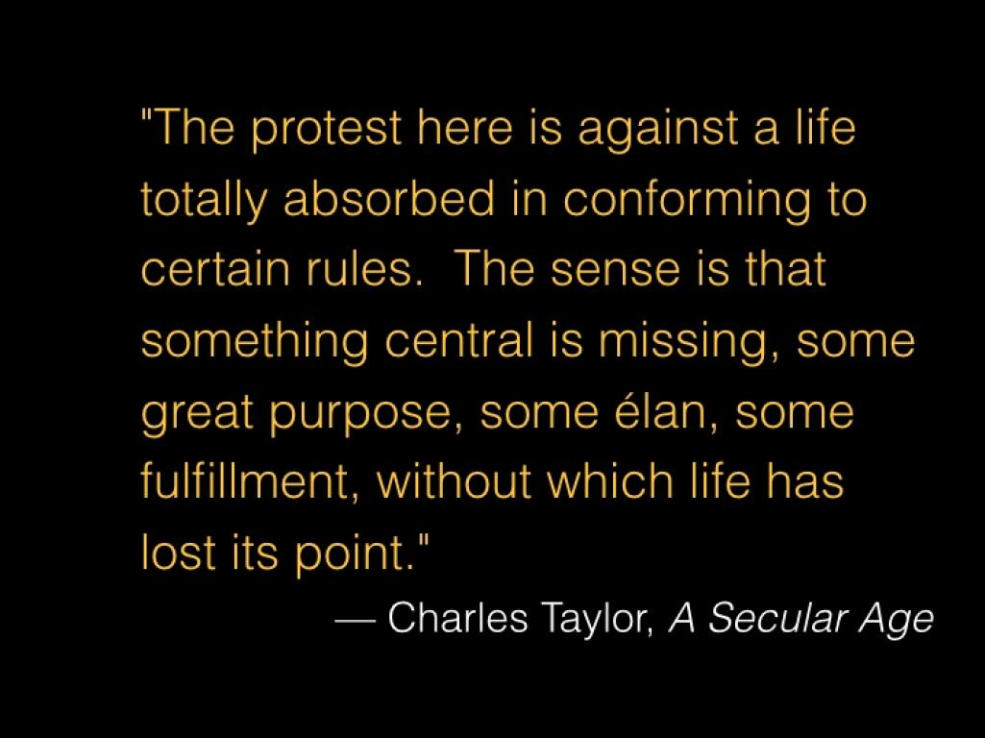

Slide 15

Believing
Belonging
Behaving
Notes:
We can see that most churches have a mix of believing, belonging, and behaving. Rick Rice's book of the same name asks us which of these should get the priority? Believing the doctrines? Belonging to the community? Or behaving according to the practices?

Slide 16
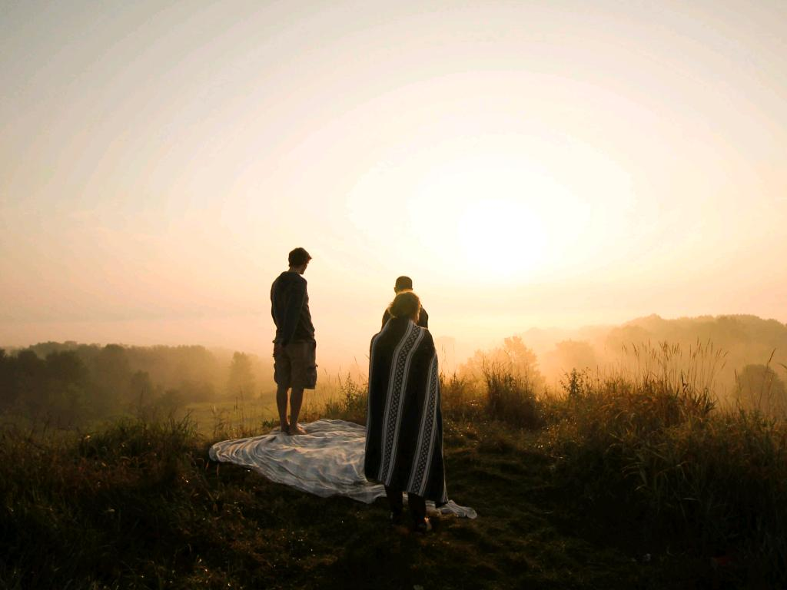
Believing
Without
Belonging
Notes:
Grace Davie, a sociologist of religion, speaks of a distancing from the Church which she calls 'believing without belonging.' While they don't attend regularly or practice attentively they may linger in times of celebration or in times of distress. In other words, they want to come home on their own terms when the need is greatest.

Slide 17
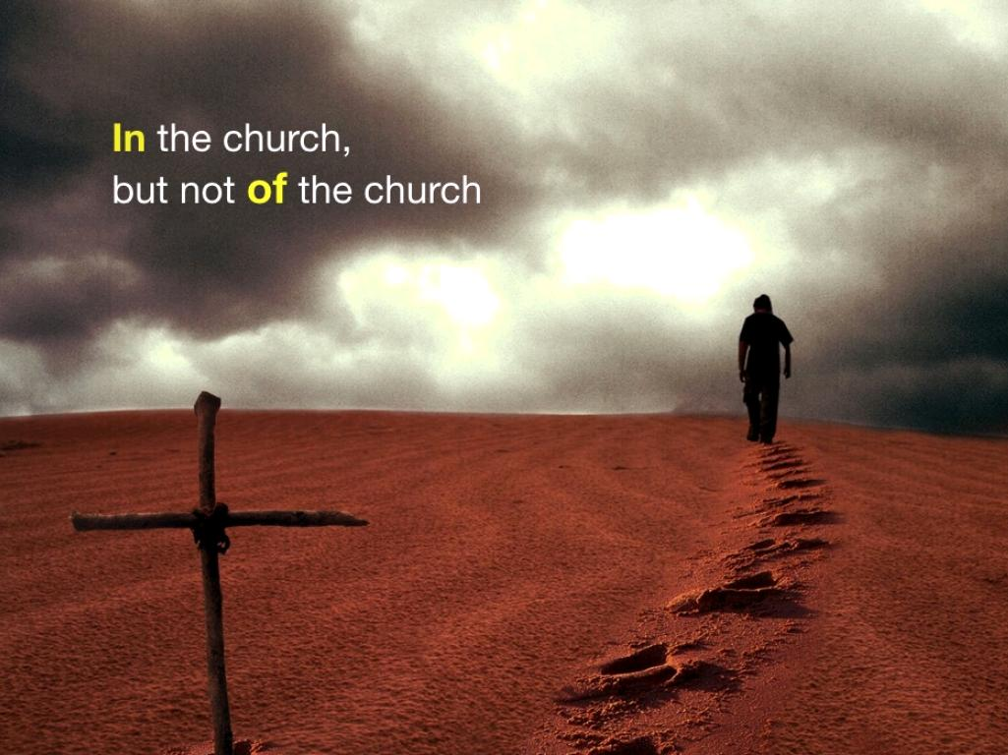
Notes:
For many of us these days, the phrase 'In the church, but not of the church,' might resonate with our experience. We might not divorce ourselves definitively from the Church, but we don't identify with its decisions and actions--in fact, we may actively disengage from outcomes we consider contrary to justice.

Slide 18

RELIGIO
TO BIND
cc: MyBarina - https://www.flickr.com/photos/73303296@N00
Notes:
We can ask, in the light of Taylor's nuanced views of secularization, what religion means? The word means 'to bind'. We can see that as constraint, a binding from something, usually the world. This view would react negatively to the authority exercised or would chafe at the restrictions.

Slide 19
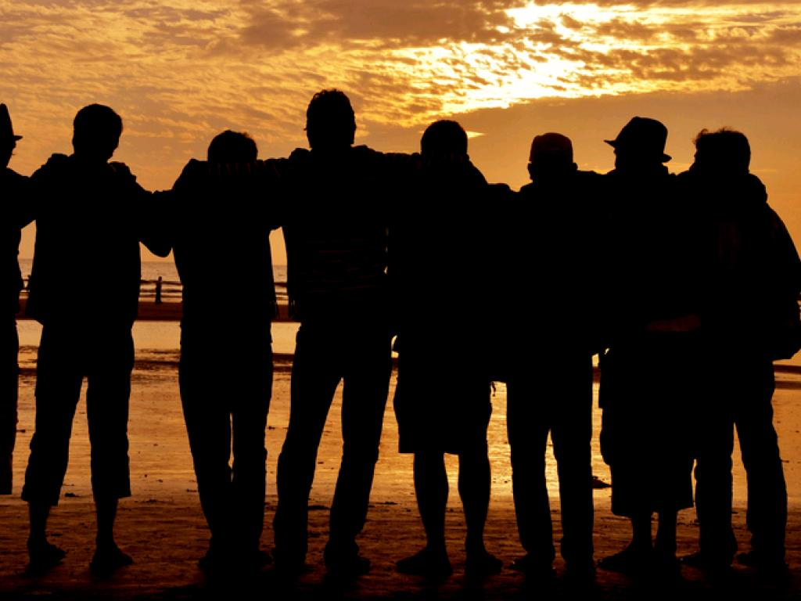
RELIGIO
TO BOND
cc: ||-SAM Nasim-|| - https://www.flickr.com/photos/65732636@N06
Notes:
But we could just as well look at 'religion' as a bonding together, in which case the priority would go to belonging, to being part of the community.

Slide 20

Authenticity
OVER AUTHORITY
Notes:
We, too, would seek authenticity over authority--revealed in a deeper understanding of our spiritual needs and a stronger devotion to Jesus. Moral issues and issues of justice would take the place of fearfulness over disobeying religious authorities.

Slide 21

PRINCIPLE
LEADING POLICY
cc: zubrow - https://www.flickr.com/photos/58980484@N08
Notes:
In this dispensation many of us long for principle to lead policy, for justice to roll down like the waters, to be free of actions taken that seem to dispose of the Gospel imperatives of justice, mercy, and compassion.

Slide 22

A BRIDGE
TO THE KINGDOM AMONG US
Notes:
In fact, an incarnational view of spirituality leads us to long for a vision of the kingdom among us and within us.

Slide 23

REWIRE CIRCUITS OF
Biblical Interpretation
Notes:
One of the priorities in this stance would be the rewiring of our biblical interpretation methods.

Slide 24
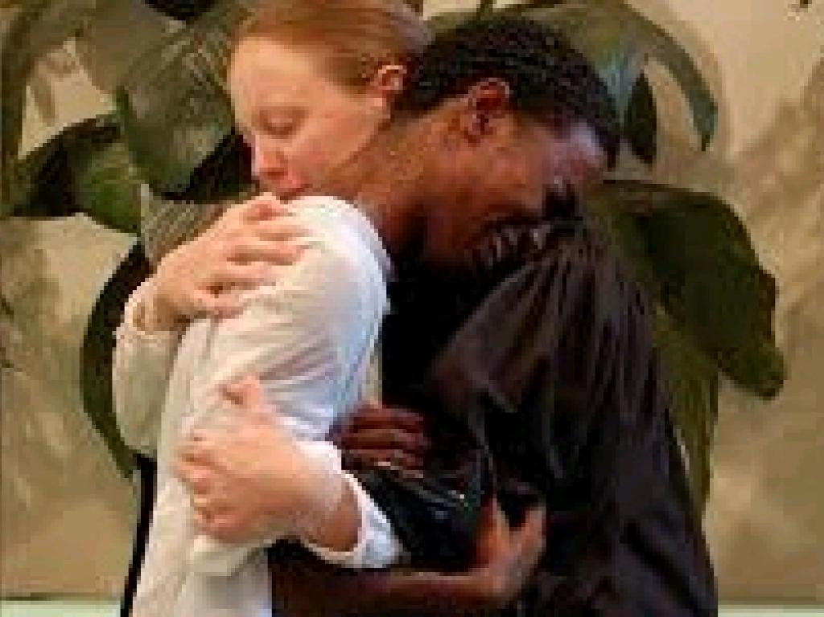
SUPPORTING AND NURTURING
WOMEN IN MINISTRY
Notes:
Perhaps the most effective thing we can do is to support and nurture women in ministry. Our relation to the world needs to be light on its feet, to be alert to the signals we receive, and to be adaptable to changing conditions. The ministry of women reaches people in ways that an exclusively male pastorate cannot.

Slide 25

Sabbath
Creation, Exodus, Solidarity
Notes:
Finally, an emphasis on the Sabbath as a balance to an eschatological or apocalyptic view. The Sabbath is a dangerous memory of Creation, of Exodus, and of Solidarity. Every week it reminds us to care for the earth, to show mercy to the captives, and walk humbly before God.

Slide 26
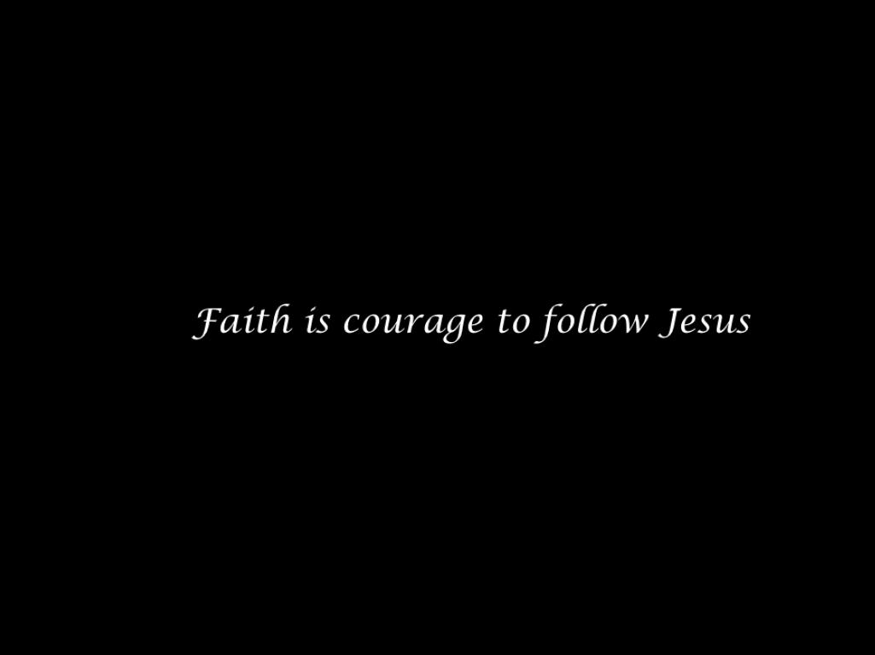
Notes:
Faith, these days, is courage to follow Jesus.

Slide 27

A VISUAL COMMUNICATION FROM
LEARN UP!

Slide 28

REFERENCES
Charles Taylor (2007). A Secular Age.
Selected photos: Unsplash.com

